Slide 1
NTTC Virtual Training Health Savings Accounts Contributions Part 1
Full Year HSA Eligible
Core
Publish date: September 15, 2020
Notes:
HSA Contributions Part 2 partial year eligibility Distributions and rules for married taxpayers covered in separate videos

Slide 2
HSA Video Series
Part 1 HSA Contributions – Core
Full year eligibility
Part 2 HSA Contributions – Comprehensive
Partial year eligibility
Part 3 Rules for Married Taxpayers – Comprehensive
Part 4 HSA Distributions – Core

Slide 3
What is a Health Savings Account
A type of savings account that allows taxpayers to set aside pre-taxed money to pay for qualified medical expenses

Slide 4
Contributions to HSA
Contributions reported on IRS Form 8889 Part I
Contributions can be made by
Eligible individual
Any other individual
Treated as gift
Deductible by the taxpayer
Employer

Slide 5
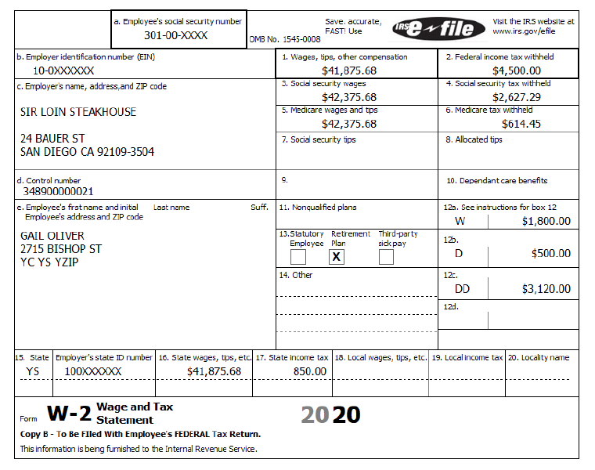
HSA Contributions Through Employer
Box 12 Code W = HSA contributions through employer
Box 12 Code W amounts not included in box 1 –
already excluded from gross income.

Slide 6
HSA Eligibility Requirements for Contributions
Pub 969
Must be covered under high deductible health plan (HDHP) for self-only or family (insurer identifies qualified plans)
Cannot be covered by other health insurance
There are exceptions
Spouse is eligible for other coverage if not HSA owner
Cannot be enrolled in Medicare
Eligible individual cannot be a dependent of another taxpayer

Slide 7
HSA Contribution and Deduction Limits
Contribution and deduction limits depend on
Type of HDHP coverage
Self-only or family – special rule for married couples (separate video)
Date taxpayer became eligible individual
Date taxpayer ceased being eligible individual
Taxpayer’s age

Slide 8
HSA Contribution and Deduction Limits
2019 HSA contribution limit
$3,500 for self-only HDHP
$7,000 for family HDHP
Additional $1,000 if age 55 or older
2020 HSA contribution limit
$3,550 for self-only HDHP
$7,100 for family HDHP
Additional $1,000 if age 55 or older

Slide 9
HSA Contribution and Deduction Limits
Reduce the amount an individual can contribute by the amount contributed through the employer
Pro-rated if not eligible for full-year contribution

Slide 10
Example 1: HSA Deduction
Carla is an eligible individual
Carla is 38
She had self-only HDHP coverage for entire year
She had her HSA for entire year
Carla can contribute and deduct up to $3,550 in 2020
Carla can contribute and deduct up to $3,500 in 2019

Slide 11
Example 2: HSA Deduction
Same as Example 1 – and –
Carla’s employer contributes $1,800 to Carla’s HSA
Reported on W-2 Box 12 code W
She can contribute and deduct up to $1,700 in 2019
($3,500 maximum contribution – $1,800 W-2 contribution)

Slide 12
Knowledge Check
Lamont has a high-deductible health plan with an HSA with his employer. His mother contributed to his HSA as a 40th birthday gift. Is this an allowable contribution?
Yes
Is Lamont allowed to deduct the contribution on his tax return or is his mother allowed the HSA deduction?
Lamont is allowed the deduction

Slide 13
Knowledge Check
Priya is retired and has no other health coverage except Medicare. She would like to open an HSA to cover her additional medical expenses. She's been shopping for high-deductible health plans. Provided she gets an HDHP, is she eligible for an HSA?
No
Why not?
She is not HSA eligible because she has Medicare coverage

Slide 14
HSA Resources
There are significant aspects of tax law that have NOT been covered. You need to be aware before you prepare a return. Find complete information in the resources below.
Pub 4012 – Tab E
Pub 4491
Pubs 969
Form 8889 Instructions
Link & Learn Taxes
NTTC Slide deck 44 Health Savings Account
NTTC HSA videos: AARP portal > search “Online Training and Video Guide”

